Slide 1

NOQUIBBLE..
To promote easy lifestyle..

Slide 2
The Great Growing Engine of change- Technology

Slide 3

Our Company's Values
1
2
3
We’re a company that pursues excellence and simplicity in all aspects.
We’re a company anchored on integrity and transparency.
We’re a company with a responsibility to give back to our community.

Slide 4
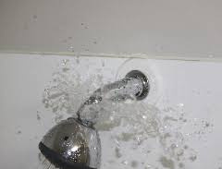
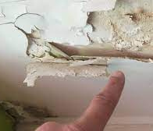


Have you ever faced these problems in your room?
Broken
Showerhead
Leakage
Problem
Tubelight not working
DoorLock
problems

Slide 5
Have you ever faced the problem of going to the warden to register your complaint..
Systems and Tools

Slide 6
It sometimes prove to be tiring to wait there
for long time....
Systems and Tools

Slide 7
But don't worry we are here with
the solution..
Systems and Tools

Slide 8
OUR AIM
To promote easily accesible mode of filling complaint

Slide 9
EXECUTION
1.Go to noquibble.com
2.Register a complaint
3.The complaint will reach to the warden directly
4. You are done now!!

Slide 10

TECH STACK
HTML
CSS
BOOTSTRAP

Slide 11

IMPROVEMENT AREAS
BACKEND | GITHUB

Slide 12

FUTURE GOALS
To promote easy lifestyle.
To promote best possible use of resources.
Adding more functionality in our website.

Slide 13

Gursehajbir Singh(Team Leader)
OUR TEAM
Parush
Kartik Kumar
Khushi Sharma
Rushil

Slide 14
Thank You..

